Slide 1
Propositional attitudes …
cause actions
resemble “intervening variables” linking environment to behaviour
have contents which may be true or false
have contents which may refer to non-existent entities
are involved in uncodifiably complex causal interactions
have contents which are individuated by senses, not only by referents
are associated with normative requirements
are indviduated in terms of their interlocking roles in causal and normative explanations of thought and action
…
Notes:
Have we plausibly overcome the conceptual and cognitive demands of full-blown theory of mind cognition?

Slide 2
Propositional attitudes …
cause actions
resemble “intervening variables” linking environment to behaviour
have contents which may be true or false
have contents which may refer to non-existent entities
are involved in uncodifiably complex causal interactions
have contents which are individuated by senses, not only by referents
are associated with normative requirements
are indviduated in terms of their interlocking roles in causal and normative explanations of thought and action
…
Notes:
Metarep conjecture

Slide 3
Propositional attitudes …
cause actions
resemble “intervening variables” linking environment to behaviour
have contents which may be true or false
have contents which may refer to non-existent entities
are involved in uncodifiably complex causal interactions
have contents which are individuated by senses, not only by referents
are associated with normative requirements
are indviduated in terms of their interlocking roles in causal and normative explanations of thought and action
…

Slide 4
Propositional attitudes …
cause actions
resemble “intervening variables” linking environment to behaviour
have contents which may be true or false
have contents which may refer to non-existent entities
are involved in uncodifiably complex causal interactions
have contents which are individuated by senses, not only by referents
are associated with normative requirements
are indviduated in terms of their interlocking roles in causal and normative explanations of thought and action
…

Slide 5
Propositional attitudes …
cause actions
resemble “intervening variables” linking environment to behaviour
have contents which may be true or false
have contents which may refer to non-existent entities
are involved in uncodifiably complex causal interactions
have contents which are individuated by senses, not only by referents
are associated with normative requirements
are indviduated in terms of their interlocking roles in causal and normative explanations of thought and action
…

Slide 6
signature limits

Slide 7
1. Charly is Samantha
2. Mitch believes that Charly is in Baltimore
3. Mitch believes that Samantha is in Baltimore
(1) & (2) ⇒ (3)

Slide 8
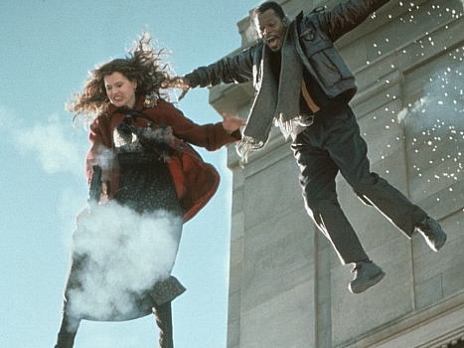
1. Charly is Samantha
2. Mitch believes that Charly is in Baltimore
3. Mitch believes that Samantha is in Baltimore
(1) & (2) ⇒ (3)

Slide 9
1. Charly is Samantha
2. Mitch believes that Charly is in Baltimore
3. Mitch believes that Samantha is in Baltimore
(1) & (2) ⇒ (3)
4. Mitch registers <Charly, Baltimore>
5. Mitch registers <Samantha, Baltimore>
(1) & (4) ⇒ (5)

Slide 10
False belief about location
False belief about identity
Subjects represent registration only
Subjects represent beliefs
pass
fail
pass
pass

Slide 11
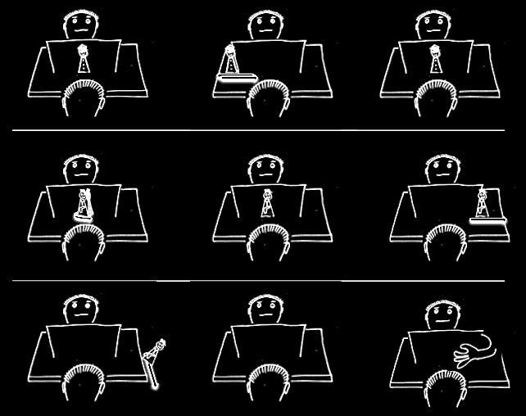

Slide 16
False belief about location
False belief about identity
Subjects represent registration only
Subjects represent beliefs
pass
fail
pass
pass

Slide 17
Rubio, Richardson & Butterfill
Notes:
First introduce them to a sequence in three slides ... [large pictures so hopefully everyone can see what’s going on]
These are all from the subject’s point of view.
We’re going to start with what looks almost exactly like the test condition from a standard false belief task.
(1) The observer watches as his car disappears behind a barrier on your [audience’s] left

Slide 18
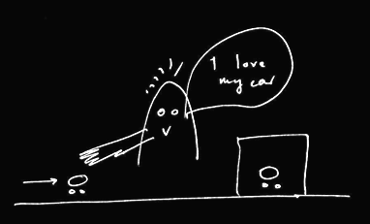
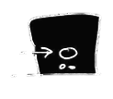
Rubio, Richardson & Butterfill
Notes:
First introduce them to a sequence in three slides ... [large pictures so hopefully everyone can see what’s going on]
These are all from the subject’s point of view.
We’re going to start with what looks almost exactly like the test condition from a standard false belief task.
(1) The observer watches as his car disappears behind a barrier on your [audience’s] left

Slide 19
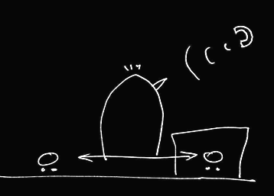

Rubio, Richardson & Butterfill
Notes:
(2) a telephone rings and the observer is distracted ... meanwhile the cars silently swap places (they’re electric cars, natch).

Slide 20
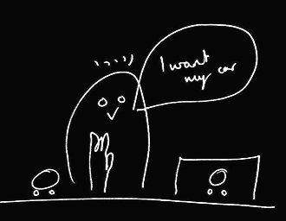
Rubio, Richardson & Butterfill
Notes:
(3) the observer comes back and wants to get her car (note the raised hand). Where do subjects look? They know that the observer’s car is actually behind the barrier. They are also in a position to know that the observer might not know this and might mistakenly think that his car is the one on subject’s LEFT.

Slide 21
her car is here
Rubio, Richardson & Butterfill
Notes:
(3) the observer comes back and wants to get her car (note the raised hand). Where do subjects look? They know that the observer’s car is actually behind the barrier. They are also in a position to know that the observer might not know this and might mistakenly think that his car is the one on subject’s LEFT.

Slide 22
she believes her car is here
her car is here
Rubio, Richardson & Butterfill
Notes:
(3) the observer comes back and wants to get her car (note the raised hand). Where do subjects look? They know that the observer’s car is actually behind the barrier. They are also in a position to know that the observer might not know this and might mistakenly think that his car is the one on subject’s LEFT.

Slide 23
she believes her car is here
her car is here
Rubio, Richardson & Butterfill
Notes:
(3) the observer comes back and wants to get her car (note the raised hand). Where do subjects look? They know that the observer’s car is actually behind the barrier. They are also in a position to know that the observer might not know this and might mistakenly think that his car is the one on subject’s LEFT.

Slide 24
we predict Ss will look here
she believes her car is here
her car is here
Rubio, Richardson & Butterfill
Notes:
(3) the observer comes back and wants to get her car (note the raised hand). Where do subjects look? They know that the observer’s car is actually behind the barrier. They are also in a position to know that the observer might not know this and might mistakenly think that his car is the one on subject’s LEFT.

Slide 25
Rubio, Richardson & Butterfill
Notes:
Here’s the whole sequence again, smaller.
If we were doing a standard false belief test, we could compare where people look in this sequence with where they look in another sequence in which the observer doesn’t turn away in the second scene.
If subjects can track false beliefs, we would expect them to be more likely to look towards SUBEJECTS-LEFT location in the depicted narrative than in the control version where the subject is not distracted by the telephone and so does not look away.
So this is almost a standard false belief task.
And like all standard false belief tasks, it requires tracking false beliefs about location only; it doesn’t require tracking false beliefs about registration.
Now consider a tiny variation ...

Slide 26
Rubio, Richardson & Butterfill
Notes:
... the middle vertical sequence is just like the right vertical sequence except that one of the barriers has been removed.
Now there are two ways of thinking about this.
On one way of thinking about it, there is no reason to think that the observer has a false belief because in the final scene (of the middle sequence) he’s looking right at a car which is not his own.
But if you think about this more carefully, that isn’t quite right because the car he’s looking at, although not his own, is visually indistinguishable from his own. So he might well believe, falsely, that his car on SUBJECTS-LEFT is actually his car.
So where subjects are capable of tracking false beliefs involving identity & where they realize that the cars are visually indistinguishable, they should be able to predict an incorrect reach.
But if subjects are not tracking about false beliefs about identity, then they will think that the observer will be able to retrieve his car from its actual location.

Slide 27
2
3
Rubio, Richardson & Butterfill
Notes:
... so let’s illustrate this with some graphs ...

Slide 28
2
3
belief: 2 ≈ 3
Rubio, Richardson & Butterfill
Notes:
... so let’s illustrate this with some graphs ...

Slide 29
2
3
belief: 2 ≈ 3
Rubio, Richardson & Butterfill
Notes:
... so let’s illustrate this with some graphs ...

Slide 30
2
3
left
right
left
right
belief: 2 ≈ 3
2
3
Rubio, Richardson & Butterfill
Notes:
... so let’s illustrate this with some graphs ...

Slide 31
2
3
left
right
left
right
belief: 2 ≈ 3
2
3
registration: 2 ≈ 3
Rubio, Richardson & Butterfill
Notes:
... so let’s illustrate this with some graphs ...

Slide 32
2
3
left
right
left
right
belief: 2 ≈ 3
2
3
registration: 2 ≈ 3
Rubio, Richardson & Butterfill
Notes:
... so let’s illustrate this with some graphs ...

Slide 33
2
3
left
right
left
right
belief: 2 ≈ 3
2
3
registration: 2 ≈ 3
left
right
left
right
2
3
Rubio, Richardson & Butterfill
Notes:
... so let’s illustrate this with some graphs ...

Slide 34
2
3
left
right
left
right
belief: 2 ≈ 3
2
3
registration: 2 ≈ 3
left
right
left
right
2
3
Rubio, Richardson & Butterfill
Notes:
... so let’s illustrate this with some graphs ...

Slide 35
Rubio, Richardson & Butterfill
Notes:
now consider a third variation ...

Slide 36

Rubio, Richardson & Butterfill
Notes:
The new sequence is the one on your [the audience’s] left.
Here the two cars are visibly distinguishable.
To us it probably seems obvious that, in the left vertical sequence, the observer will reach behind the barrier. Whereas this is not nearly so obvious in the middle vertical sequence. But now consider someone incapable of reasoning about false beliefs involving identity. From her point of view, the two sequences are not different. To her what matters is just that numerically distinct objects appear on the left. So (assuming she doesn’t lose track of the objects) she has no more reason to think that the observer will reach behind the barrier in the middle sequence than she does in the left sequence.

Slide 37
1
2
3
Rubio, Richardson & Butterfill
Notes:
... lets illustrate this with some graphs

Slide 38
1
2
3
belief: 2 ≈ 3
registration: 2 ≈ 3
belief: 1 ≈ 2
registration: 1 ≈ 2
Rubio, Richardson & Butterfill
Notes:
... lets illustrate this with some graphs

Slide 39


Slide 40
challenge
Explain the emergence, in evolution or development, of full-blown theory of mind cognition.
puzzle
What could infants, chimps and scrub-jays represent that would enable them, within limits, to track others’ perceptions, knowledge, beliefs and other propositional attitudes?

Slide 41
challenge
Explain the emergence, in evolution or development, of full-blown theory of mind cognition.
puzzle
What could infants, chimps and scrub-jays represent that would enable them, within limits, to track others’ perceptions, knowledge, beliefs and other propositional attitudes?

Slide 42
minimal theory of mind cognition
joint action (ability to share goals)
understanding communicative intent
other stuff
communication by language
other stuff
full-blown theory of mind cognition

Slide 44
"We … use the acronym ToM, to refer to any cognitive system, whether theory-like or not, that predicts or explains the behaviour of another agent by postulating that unobservable inner states particular to the cognitive perspective of that agent causally modulate that agent’s behaviour."
(Penn & Povinelli 2007: 732)

Slide 45
"We … use the acronym ToM, to refer to any cognitive system, whether theory-like or not, that predicts or explains the behaviour of another agent by postulating that unobservable inner states particular to the cognitive perspective of that agent causally modulate that agent’s behaviour."
(Penn & Povinelli 2007: 732)

Slide 46
"We … use the acronym ToM, to refer to any cognitive system, whether theory-like or not, that predicts or explains the behaviour of another agent by postulating that unobservable inner states particular to the cognitive perspective of that agent causally modulate that agent’s behaviour."
(Penn & Povinelli 2007: 732)

Slide 47
"We … use the acronym ToM, to refer to any cognitive system, whether theory-like or not, that predicts or explains the behaviour of another agent by postulating that unobservable inner states particular to the cognitive perspective of that agent causally modulate that agent’s behaviour."
(Penn & Povinelli 2007: 732)

Slide 48
X preens me
X sings
X likes me
preen X

Slide 49
X preens me
X sings
X likes me
preen X

Slide 50
X preens me
X sings
X likes me
preen X

Slide 51
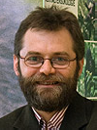
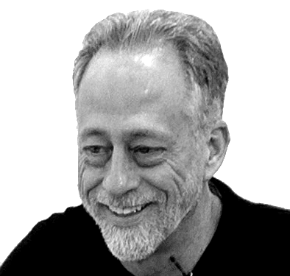
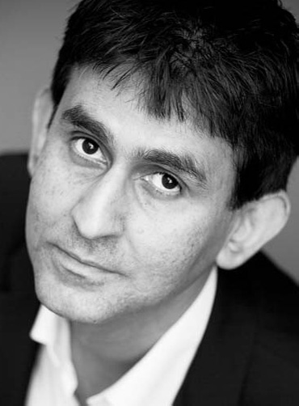
“chimpanzees understand … intentions … perception and knowledge … Moreover, they understand how these psychological states work together to produce intentional action”
(Call & Tomasello 2008:191)
“our fundamental understanding of […] knowledge is that it is something whose possession by an individual can properly be explained by reference to […] ways of coming to know.”
(Cassam “What is Knowledge?”, forthcoming)

